Slide 1
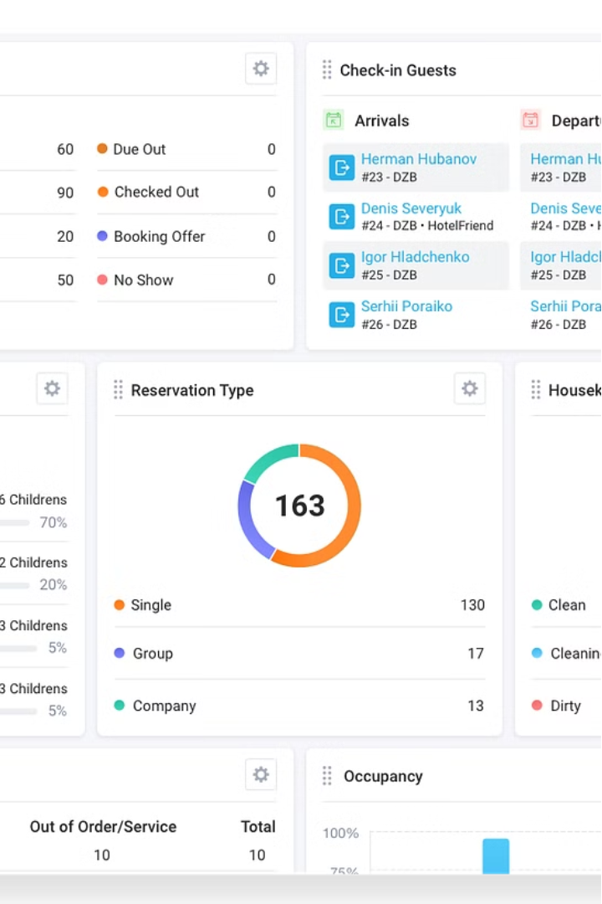


Unleashing Insights from Hotel Listings
This comprehensive Power BI analysis project aims to unlock invaluable insights from a rich dataset of hotel aggregator listings. By exploring a diverse set of attributes, from geographical distribution and pricing patterns to host characteristics and guest reviews, we will uncover the key drivers influencing the performance and competitiveness of these listings. Through interactive visualizations and in-depth reporting, this project will empower hoteliers, platform owners, and data analysts to make data-driven decisions that elevate the guest experience and optimize listing strategies.
by Alok Panwar

Slide 2
Geographical Insights
Visualizing Locations
Host Density
Competitive Landscape
By mapping the geographical distribution of listings, we can identify the most popular neighborhoods and areas of high demand. This spatial analysis will reveal clustering patterns and highlight areas with significant concentrations of hotel offerings, providing valuable insights for expansion, market penetration, and targeted marketing strategies.
Exploring the geographical spread of host locations can uncover insights about accessibility, local expertise, and the potential for collaborative efforts among hoteliers. Identifying regions with high host density versus those with sparse representation can inform recruitment campaigns, partnership opportunities, and the development of localized support networks.
Analyzing the geographical distribution of listings can also shed light on the competitive landscape, highlighting areas with high saturation or potential for differentiation. This information can guide strategic decision-making around pricing, unique selling propositions, and the identification of underserved market segments.

Slide 3
Pricing and Availability Trends
Occupancy Trends
Pricing Analysis
By analyzing occupancy rates and trends, we can identify opportunities to increase bookings, address underperforming periods, and align pricing strategies with market demand. This insight can inform targeted marketing campaigns, strategic partnerships, and the development of tailored offerings to cater to evolving guest preferences.
Delving into pricing trends based on property types, room configurations, and accommodation capacity will reveal valuable insights. We can identify the drivers of pricing, such as location, amenities, and seasonality, and uncover opportunities for targeted pricing strategies to optimize revenue and occupancy rates.
1
2
3
Availability Patterns
Examining the availability of listings over time can help us pinpoint peak demand periods, seasonal fluctuations, and potential supply-demand imbalances. This analysis can guide revenue management decisions, inventory optimization, and the development of dynamic pricing models to ensure competitive positioning and enhanced guest experiences.

Slide 4
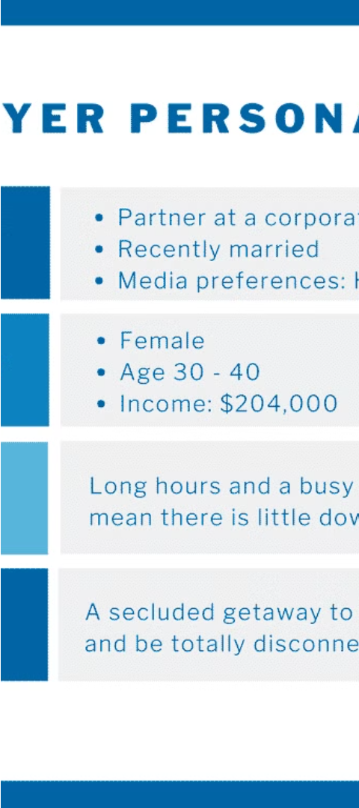
Empowering Hosts
1
Superhost Evaluation
2
Response Time Impact
Assessing the characteristics and performance of superhosts can uncover the key factors that contribute to their success. This analysis can guide the development of targeted training programs, recognition initiatives, and mentorship opportunities to help elevate the overall quality of host offerings and guest experiences.
Exploring the relationship between host response times and listing performance can shed light on the importance of prompt and effective communication in the hospitality industry. This insight can inform host coaching, streamlined support systems, and the implementation of policies that prioritize responsiveness and guest satisfaction.
3
Verification Influence
Evaluating the impact of host verification methods on listing popularity and guest trust can guide platform enhancements and host onboarding processes. By understanding the significance of verified identities, reviews, and other credibility indicators, we can implement strategies to build confidence and foster stronger connections between hosts and guests.

Slide 5

Elevating Guest Satisfaction
Review Score Impact
Actionable Feedback
Sentiment Analysis
Analyzing the relationship between review scores and overall listing performance can provide valuable insights. By understanding the key drivers of guest satisfaction, as reflected in review data, we can identify areas for improvement and develop targeted strategies to enhance the guest experience, ultimately driving increased bookings and revenue.
Delving into the specific review categories can uncover granular insights about guest preferences, pain points, and opportunities for improvement. This analysis can inform operational enhancements, service upgrades, and the development of personalized offerings to better meet the evolving needs and expectations of guests.
Applying sentiment analysis techniques to guest reviews can provide deeper understanding of the emotional resonance and overall sentiment towards listings. This insight can guide the refinement of marketing messages, the optimization of property features, and the cultivation of a more positive and engaging guest experience.

Slide 6



Accommodation Preferences
Property Types
Room Configurations
Amenity Preferences
Exploring the distribution of property types, such as apartments, houses, and hotels, can reveal valuable insights about guest preferences and market segmentation. This analysis can inform strategic decisions around diversifying property offerings, targeted marketing, and the development of specialized services to cater to the unique needs of different traveler segments.
Analyzing the popularity and performance of various room types, including the number of bedrooms, bathrooms, and occupancy capacities, can guide the optimization of listing portfolios. This insight can help hosts and platform owners align their offerings with guest demand, enhancing the overall competitiveness and appeal of the listings.
Identifying the most valued amenities and guest preferences can inform the development of targeted marketing campaigns, the enhancement of property features, and the implementation of personalized recommendations. By catering to the specific needs and expectations of guests, we can drive increased bookings and elevate the overall guest experience.

Slide 7
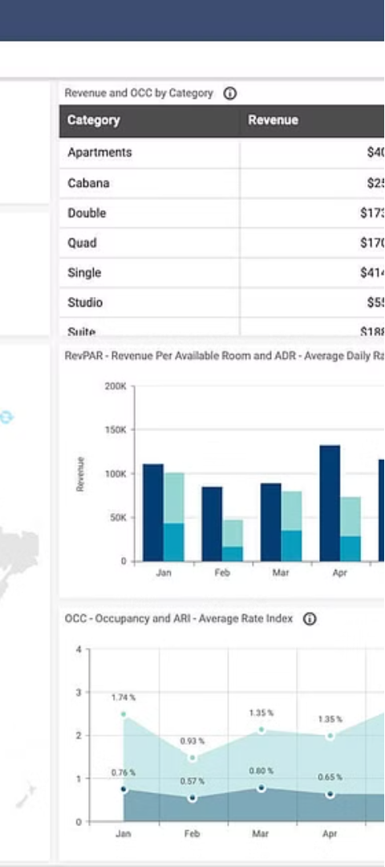



Uncovering Patterns
Correlation Analysis
Exploring the relationships between various attributes, such as pricing, reviews, and host characteristics, can uncover hidden patterns and interdependencies. This analysis can help identify the key factors that drive listing performance, informing strategic decision-making and the development of data-driven optimization strategies.
Segmentation Insights
Applying advanced segmentation techniques to the dataset can reveal distinct clusters of listings, hosts, and guest preferences. This segmentation can guide the development of tailored marketing campaigns, targeted pricing strategies, and the creation of personalized experiences to better serve the needs of different traveler segments.
Predictive Modeling
Leveraging predictive analytics, we can develop models to forecast future trends, anticipate demand fluctuations, and identify high-potential listings. These insights can inform strategic planning, risk management, and the implementation of proactive measures to enhance the overall competitiveness and profitability of the hotel aggregator platform.

Slide 8
Delivering Actionable Insights
Geographical Insights
Understand the spatial distribution of listings and host locations to identify expansion opportunities, competitive landscape, and accessibility for guests.
Pricing and Availability
Analyze pricing trends, seasonal fluctuations, and occupancy patterns to optimize revenue management, inventory control, and dynamic pricing strategies.
Host Performance
Evaluate host characteristics, communication, and verification to develop targeted training, recognition programs, and support systems that elevate the overall quality of listings.
Guest Satisfaction
Examine review scores, sentiment, and feedback to identify areas for operational improvements, service enhancements, and the development of personalized offerings.
By leveraging the power of Power BI, this comprehensive analysis will provide hoteliers, platform owners, and data-driven decision-makers with a robust set of insights and recommendations to enhance the competitiveness, profitability, and guest experience of hotel aggregator listings. The interactive dashboards, informative reports, and actionable insights generated through this project will empower stakeholders to make data-driven decisions and drive meaningful improvements within the hotel industry.

